Slide 1
Mathematical Operations on the Different Bases in the Number System
Lecturer: Jay A. Abaleta

Slide 2
Binary Arithmetic
Introduction
Binary arithmetic is essential part of all the digital computers and many other digital system.
It can be very useful to know, however.
These processes are often steppingstones to more complex processes which can do very powerful things.

Slide 3
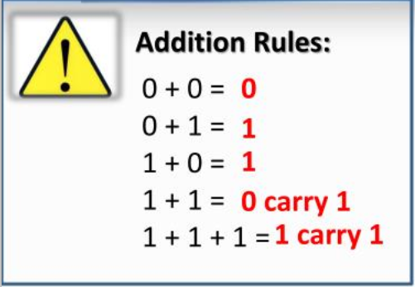
The Binary Addition
Binary addition is the easiest of the processes to perform.
It is a key for binary subtraction, multiplication, division.

Slide 4
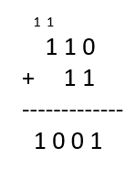
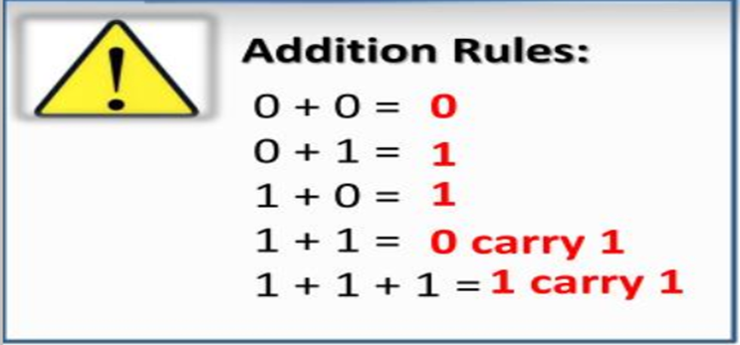
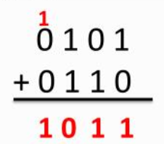
Example:

Slide 5
The Binary Multiplication
Binary multiplication is similar to decimal multiplication.
It is simpler than decimal multiplication because only 0s and 1s are involved.
There are four rules of binary multiplication.

Slide 6
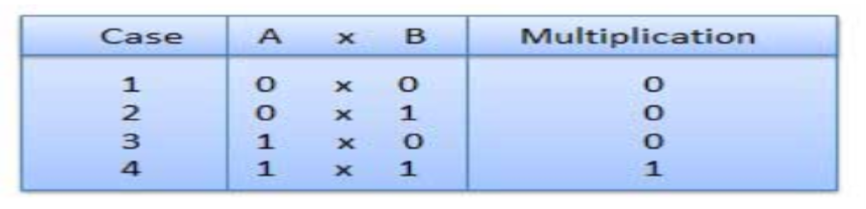
Example:

Slide 7
The Binary Subtraction
Similar to binary addition, we will work through the numbers, column by column, starting on the far right. Instead of carrying forward however, we will borrow backwards (when necessary).
Here are the rules:
0 - 0 = 0
1 - 0 = 1
1 - 1 = 0
0 - 1 we can't do so we borrow 1 from the next column. This makes it 10 - 1 which is 1.

Slide 8
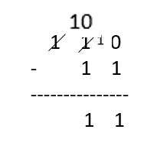
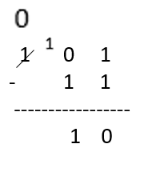
Example:
0 - 0 = 0
1 - 0 = 1
1 - 1 = 0
0 - 1 we can't do so we borrow 1 from the next column. This makes it 10 - 1 which is 1.

Slide 9


The Binary Division
Binary division is similar to decimal division.
It is called as the long division procedure.
The number we are dividing by is the divisor.
The number we are dividing into is the dividend.

Slide 10

The Binary Division
The process is as follows:
Step 1: Create the working portion of the dividend. Starting at the right, keep including digits until we have a number that the divisor will go into.
Step 2: Work out how many times the divisor goes into the working portion (with binary this is easy as it will always be 1). Write this number above the line (in line with the far right digit of the working number).
Step 3: Subtract the divisor from the working number. This becomes the beginning of the new working number.
Step 4: Bring down digits from the dividend and add to the new working number until we have a new working number large enough for the divisor to go into.
Step 5: Repeat steps 2 to 4 until we are at the end of the dividend.
Step 6: The result of the final subtraction is the remainder.

Slide 11
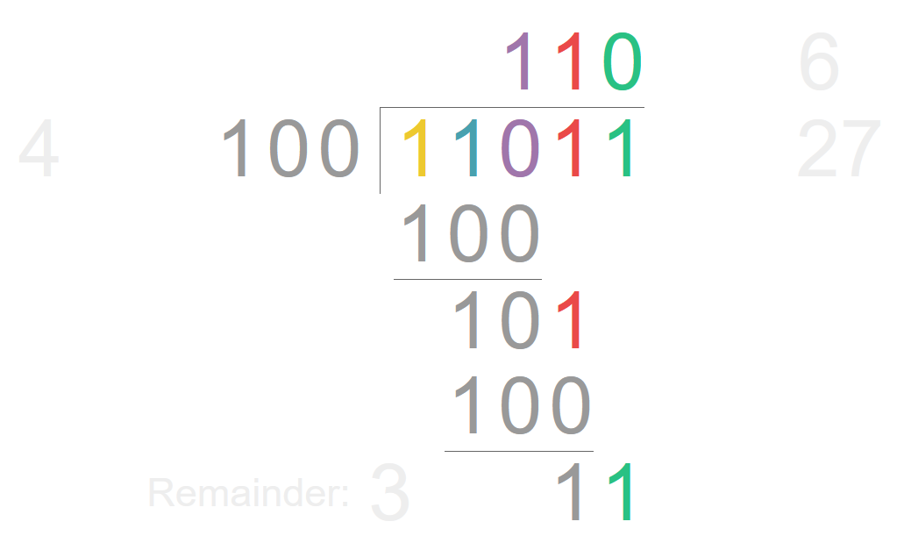
Example # 1

Slide 12
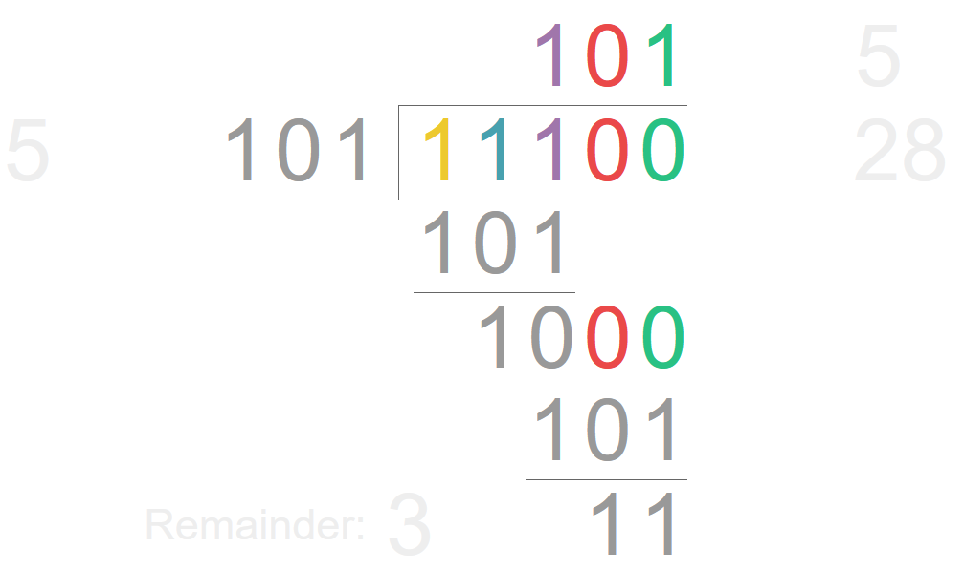
Example # 2

Slide 13
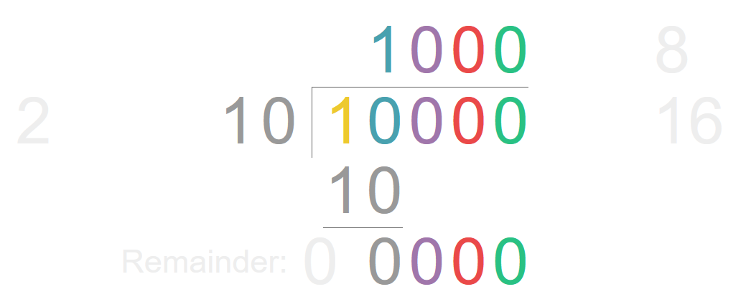
Example # 3

Slide 14
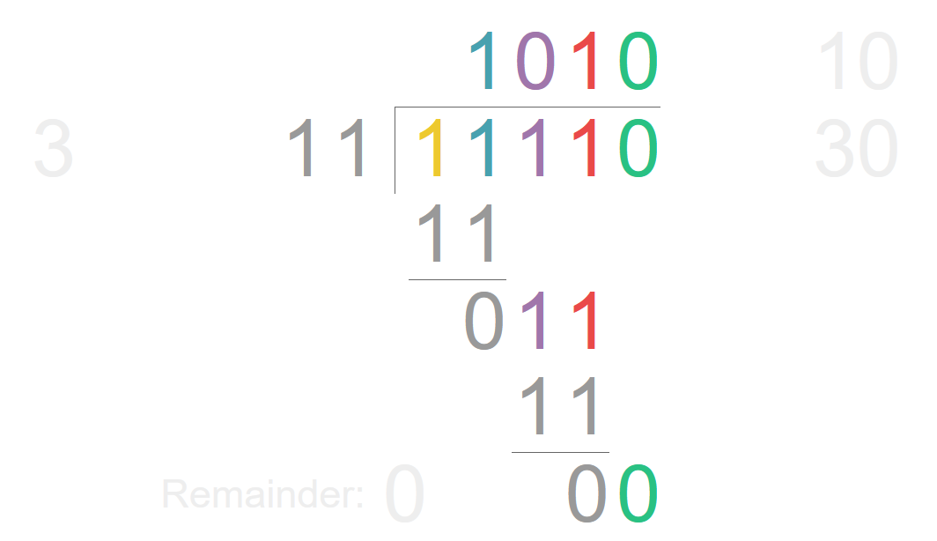
Example # 4

Slide 15
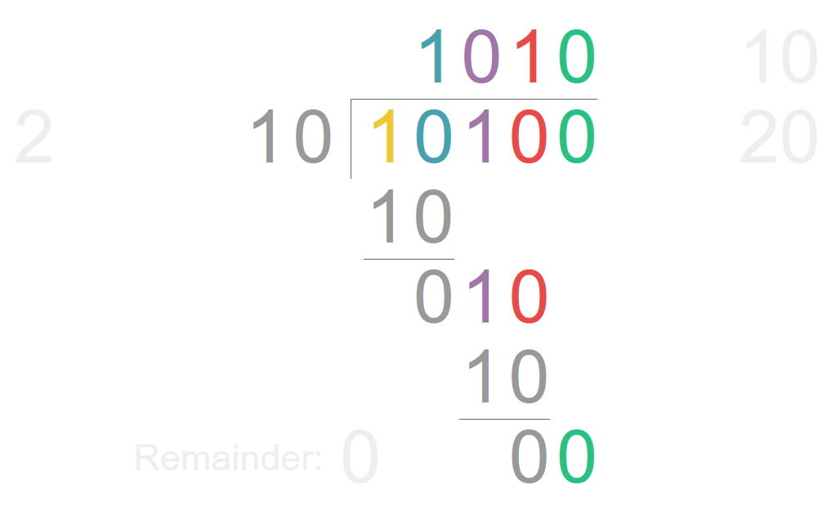
Example # 5

